Slide 1



Moral Judgements Online Learning Noceboes for Infectious Risk (MJOLNIR)
July 20, 2022

Slide 2
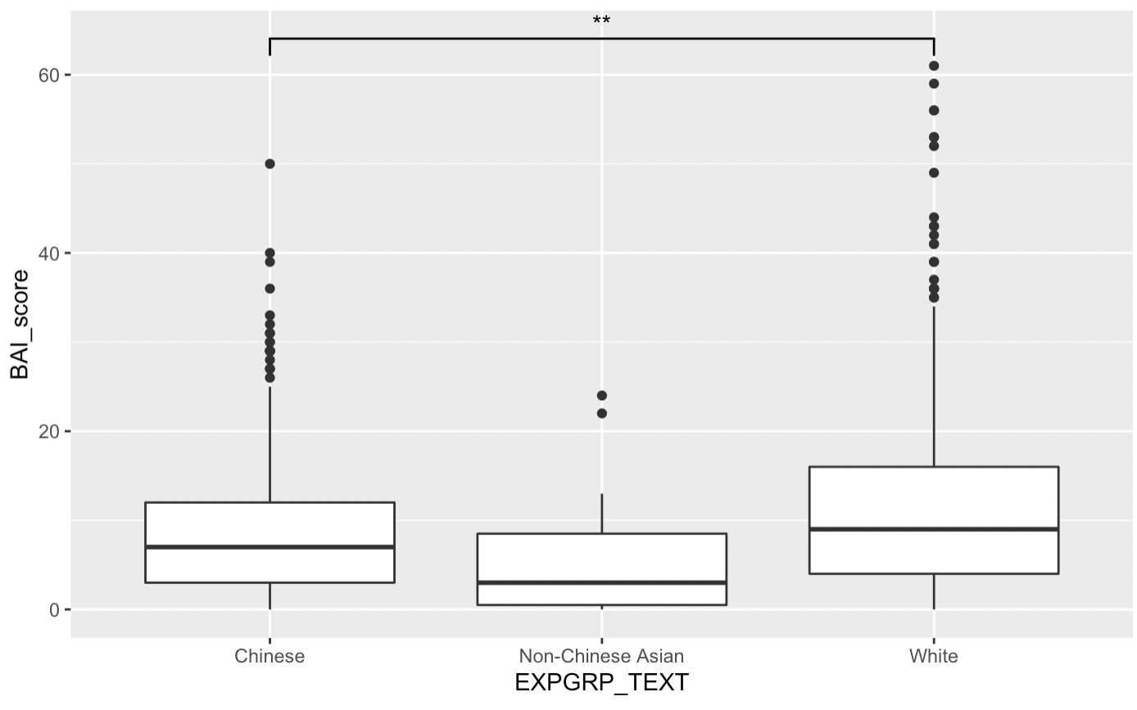
White participants are significantly more anxious than Chinese participants
(p < .01)

Slide 3
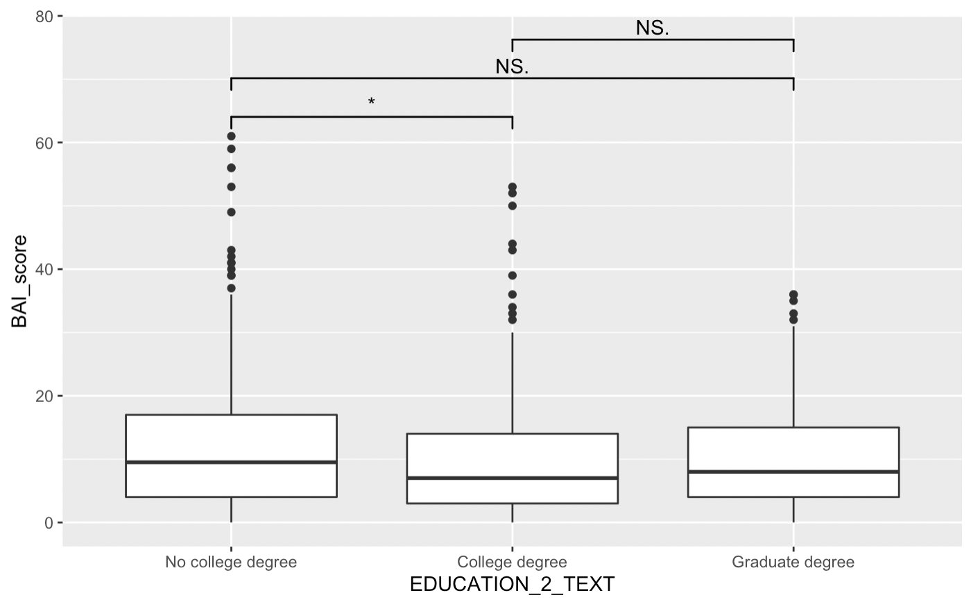
Participants with a college degree were less anxious than participants who did not complete one
(p < .05)

Slide 4
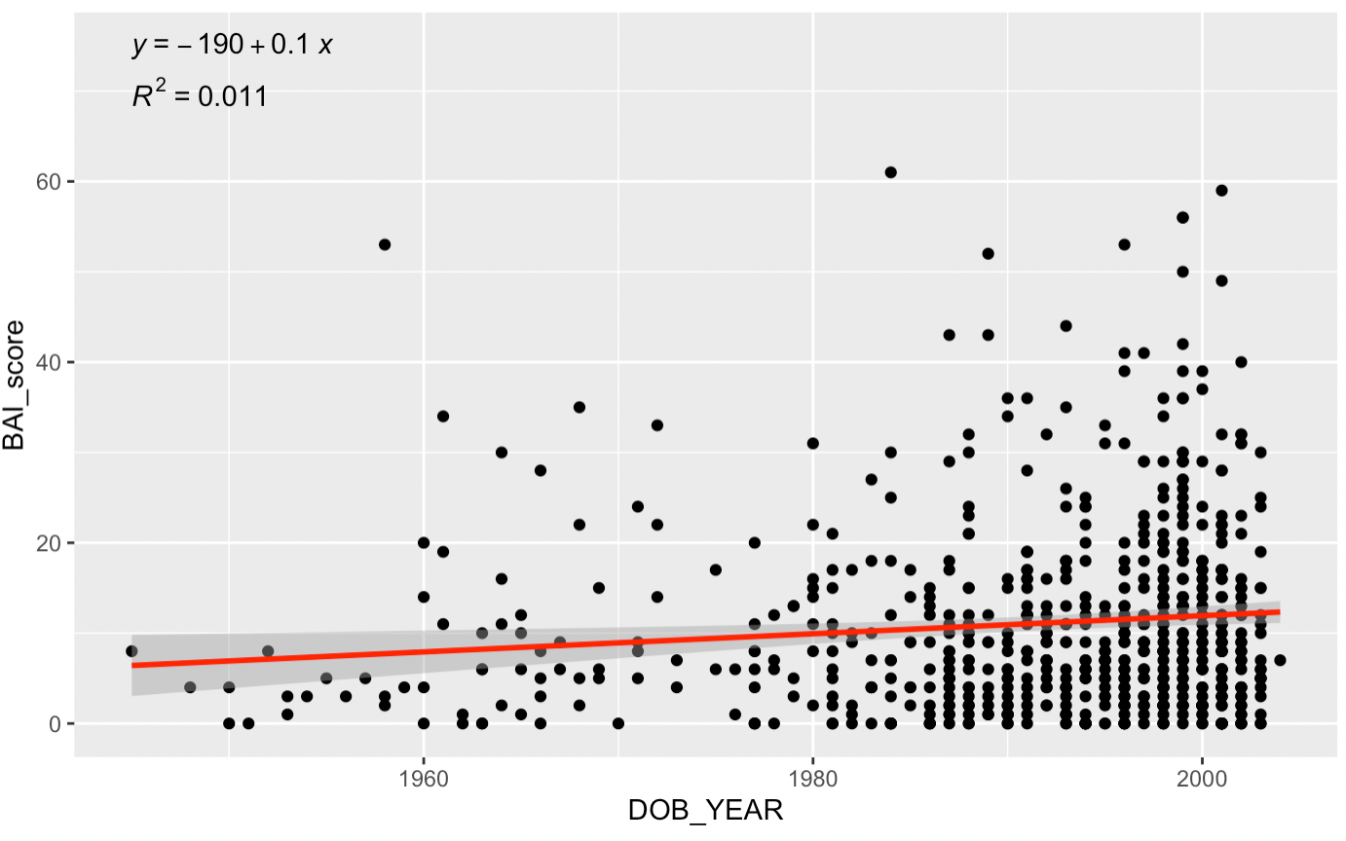
Anxiety wanes as one gets older
(p < .01)

Slide 5
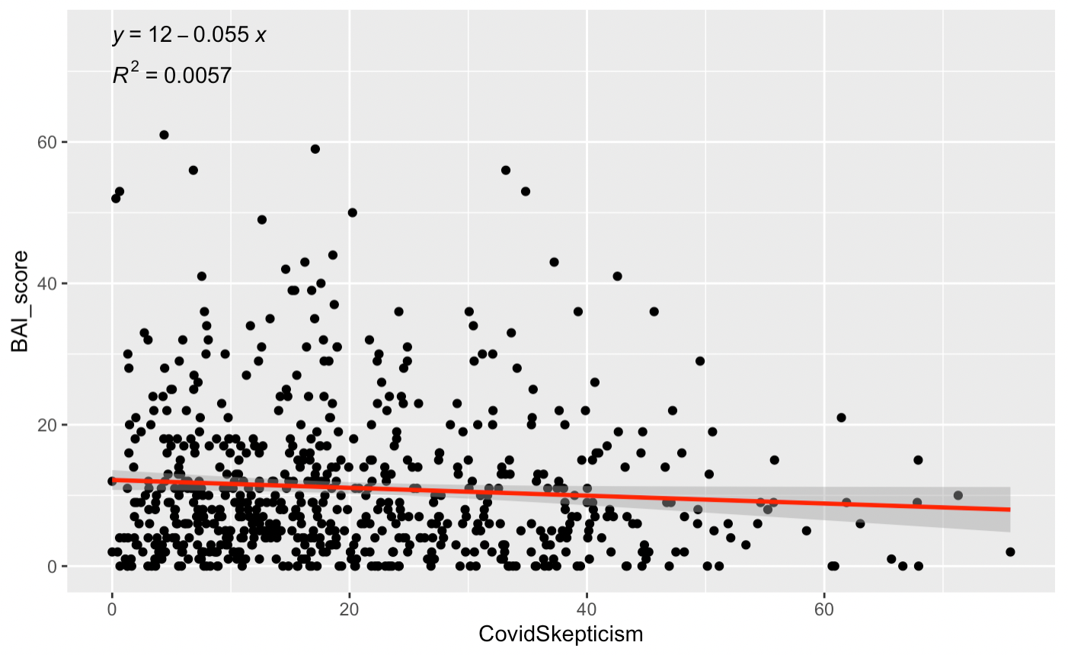
No significant link between anxiety and Covid skepticism
(p > .05)

Slide 6
H1a. Can observed situational cues such as the hoarding of certain objects or the perceived race of a person produce a "devil effect", negatively influencing moral judgments and subsequently “spilling over” into the socially-divisive judgments about other people's potential to contract and transmit COVID-19?
H1b. Are morality judgments about the self stable by contrast?
H2a. Do reported patterns of judgments reflect something akin to a fundamental attribution error, whereby individuals rate themselves as more moral (self-targeted moral-favoritism) and others as less moral (other-targeted moral-denigration), and therefore less prone to contracting and transmitting COVID-19 than others?
H2b. Is self-targeted moral-favoritism or other-targeted moral-denigration more responsible for increases in judgments about other people's potential to contract and transmit COVID-19?
H2c. Does self-targeted moral-favoritism drive other-targeted moral-denigration?
H3a. Does people reduce their attributions of COVID-19 contraction and transmission probability after learning prosocial information about a person by mitigating other-targeted moral denigration?
H3b. Does self-targeted moral-favoritism maintain other-targeted moral-denigration and reduce learning effects due to prosocial information?
H4. In the context of COVID-19, are there differences in cue-based situational judgments about others and the self between Chinese and Whites, especially when the target is perceived to be Chinese compared to if they are perceived to be White, Black/African American, or Indian/Sri-Lankan?

Slide 7






Slide 8
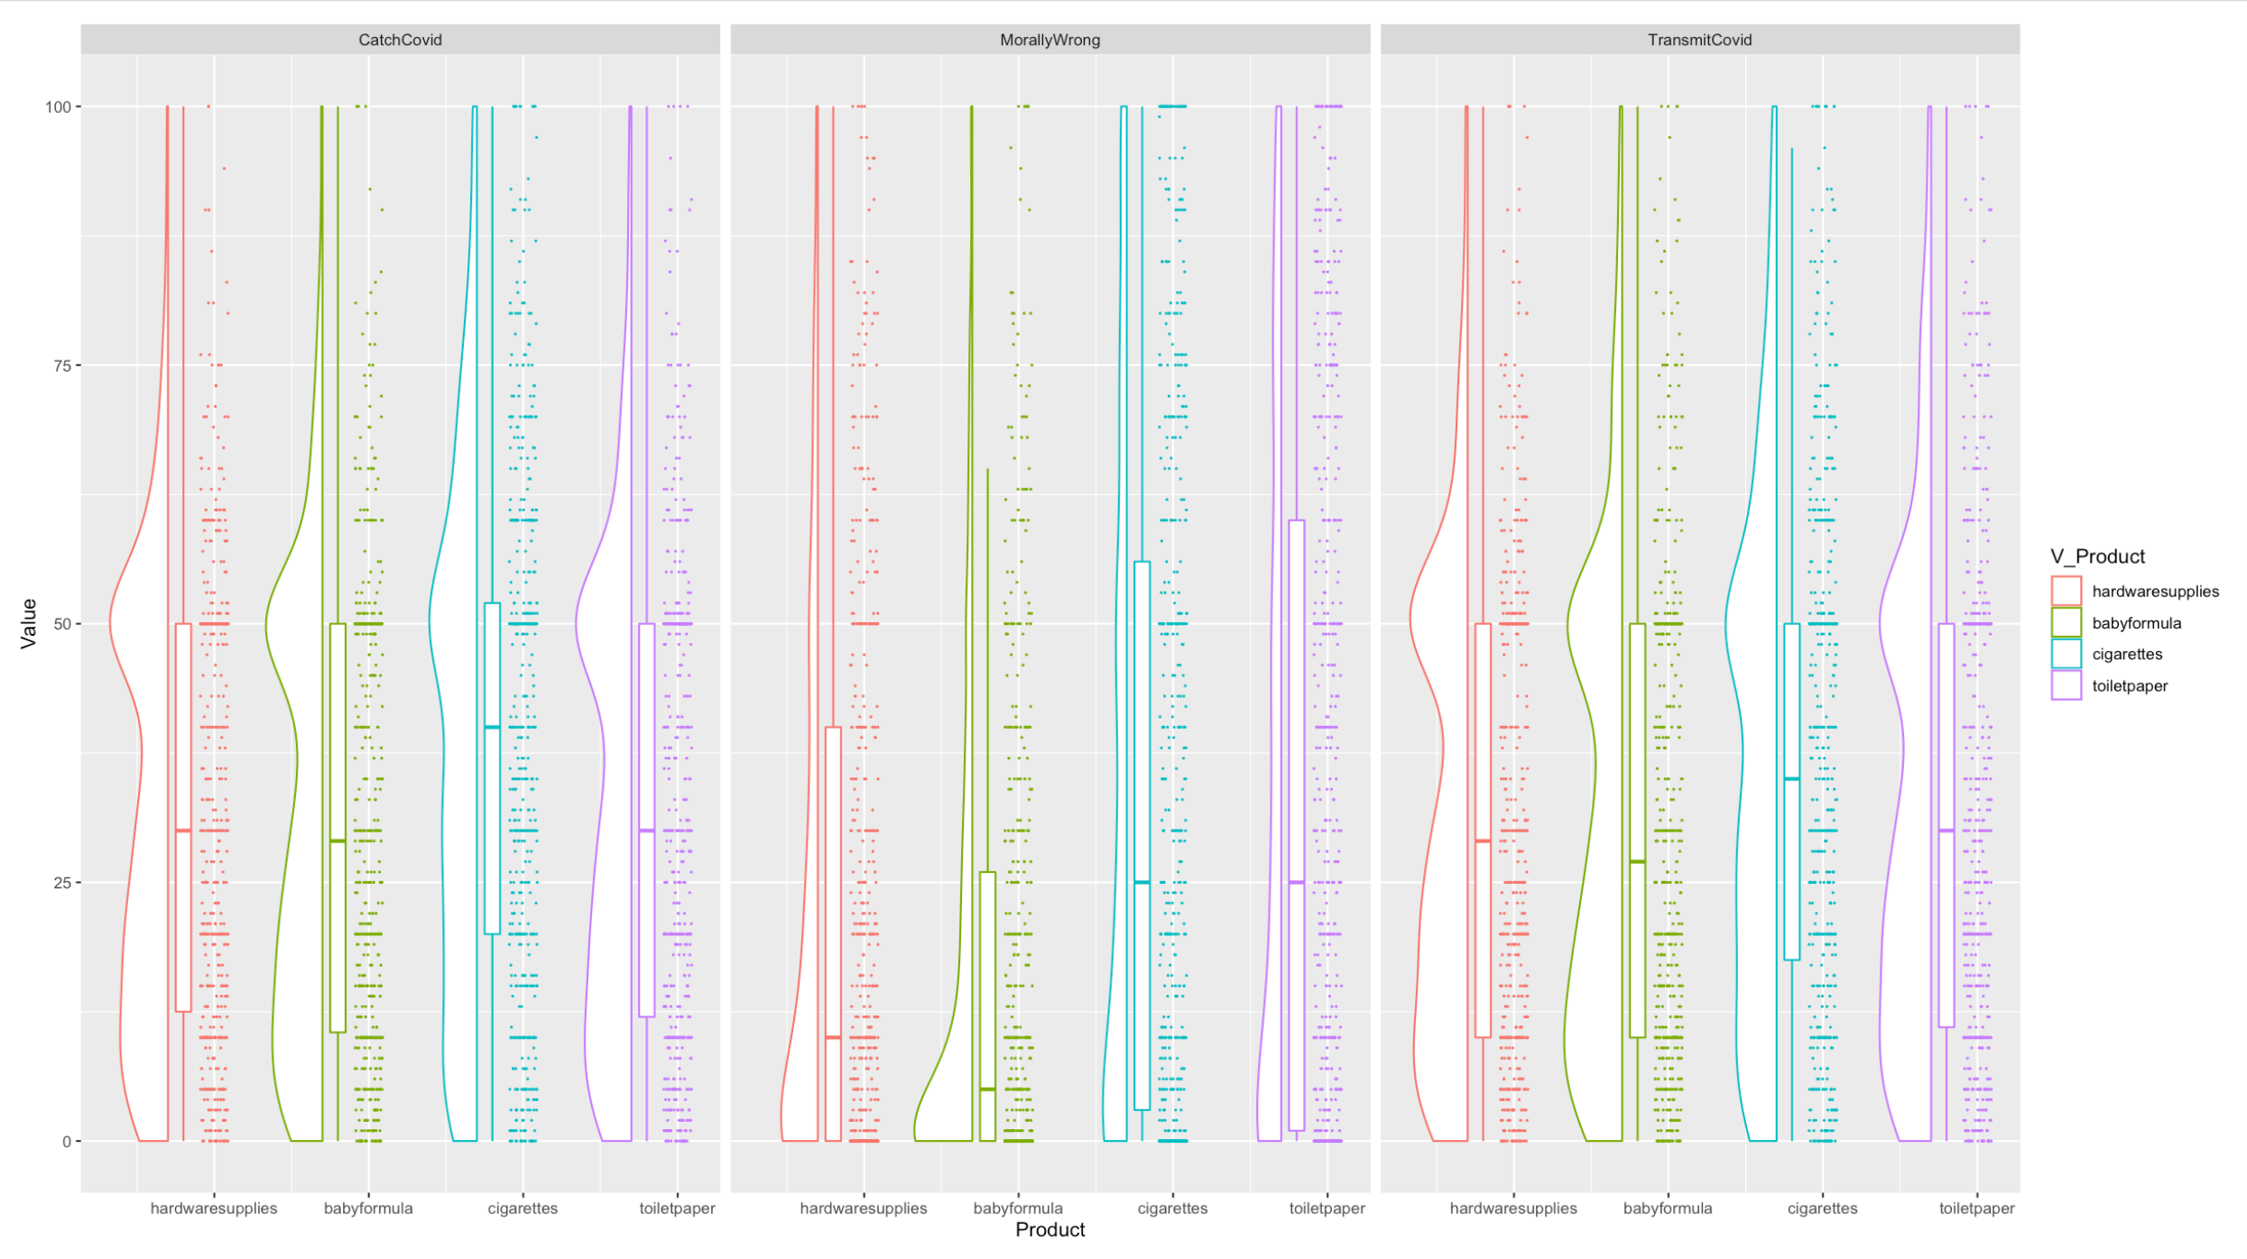
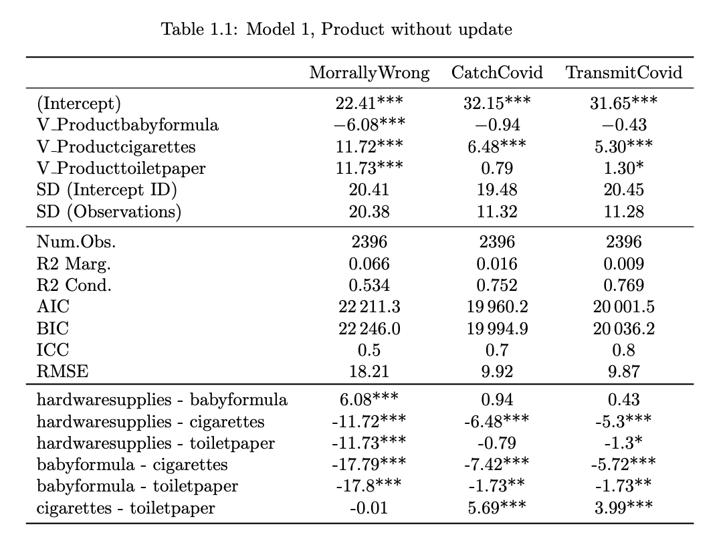
1.1 Product Model
>
>
=

Slide 9
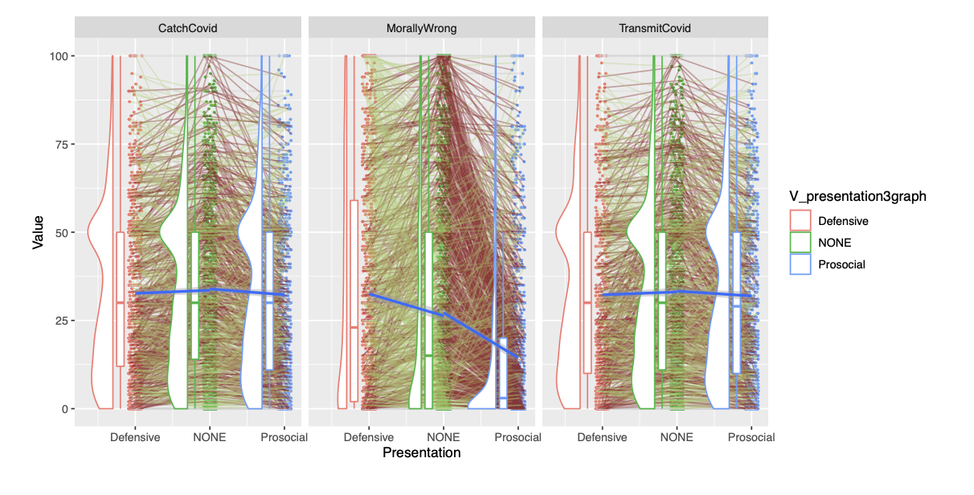
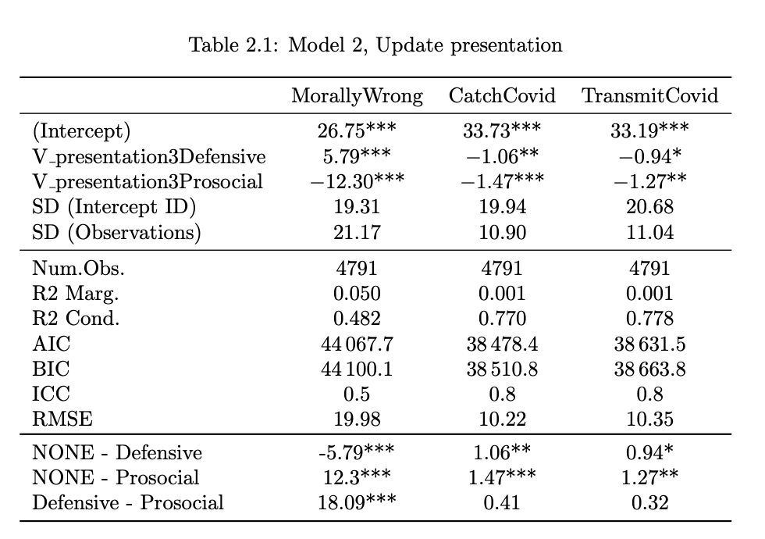
1.2 Update Model

Slide 10
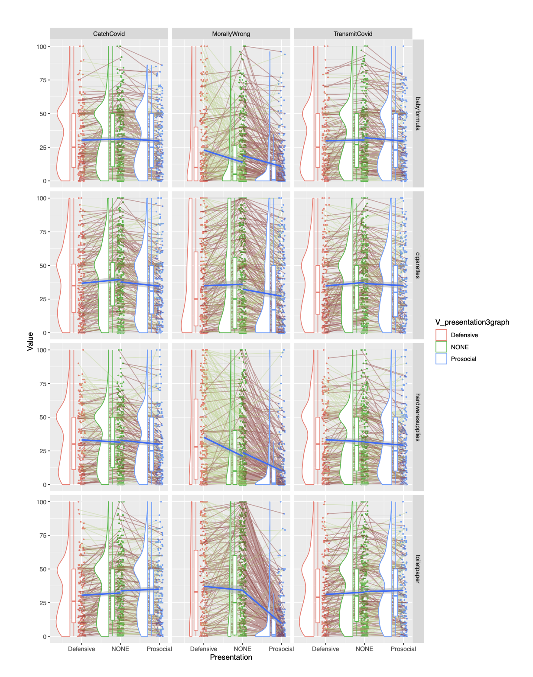
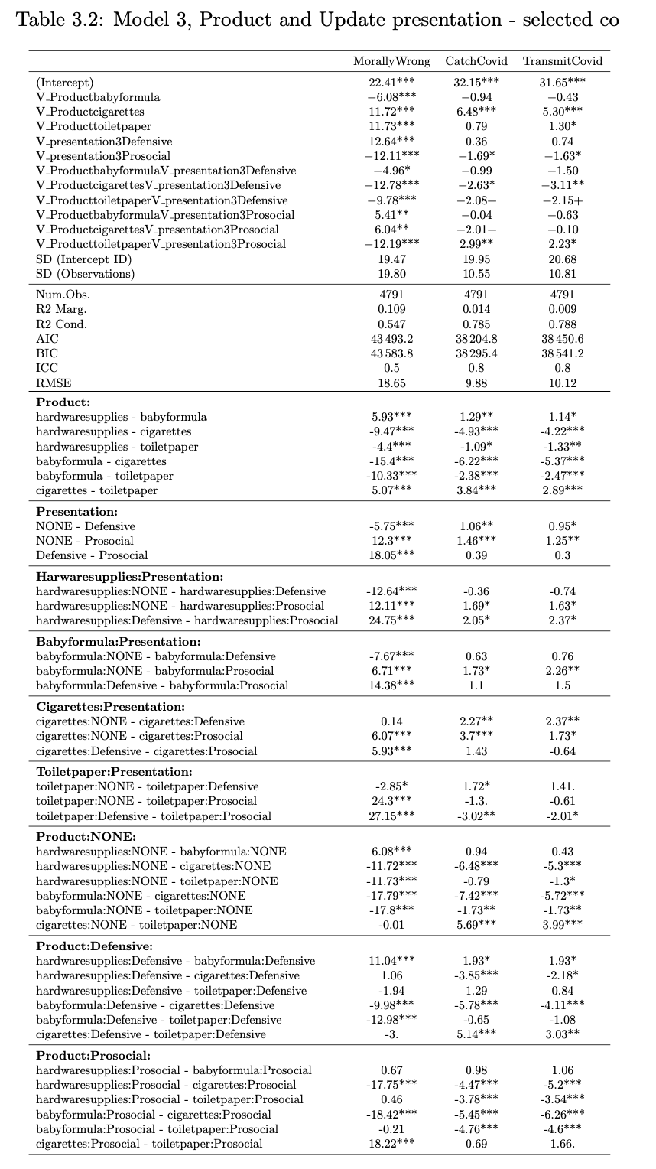
1.2 Update Model

Slide 11
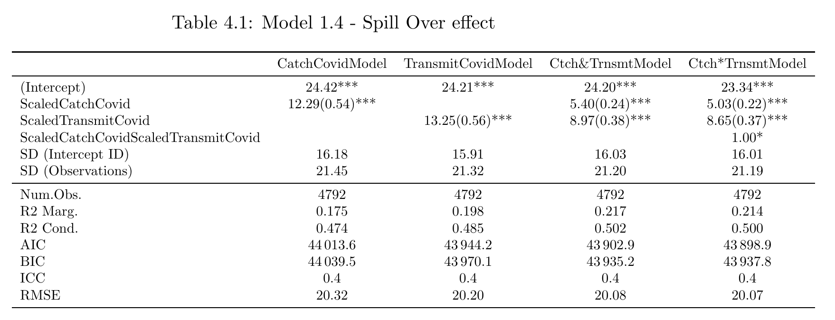
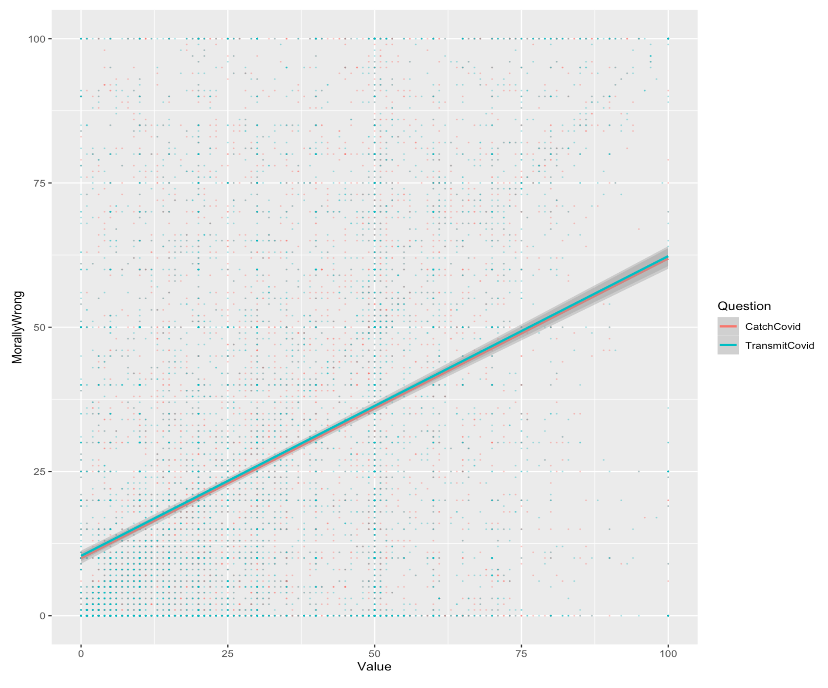
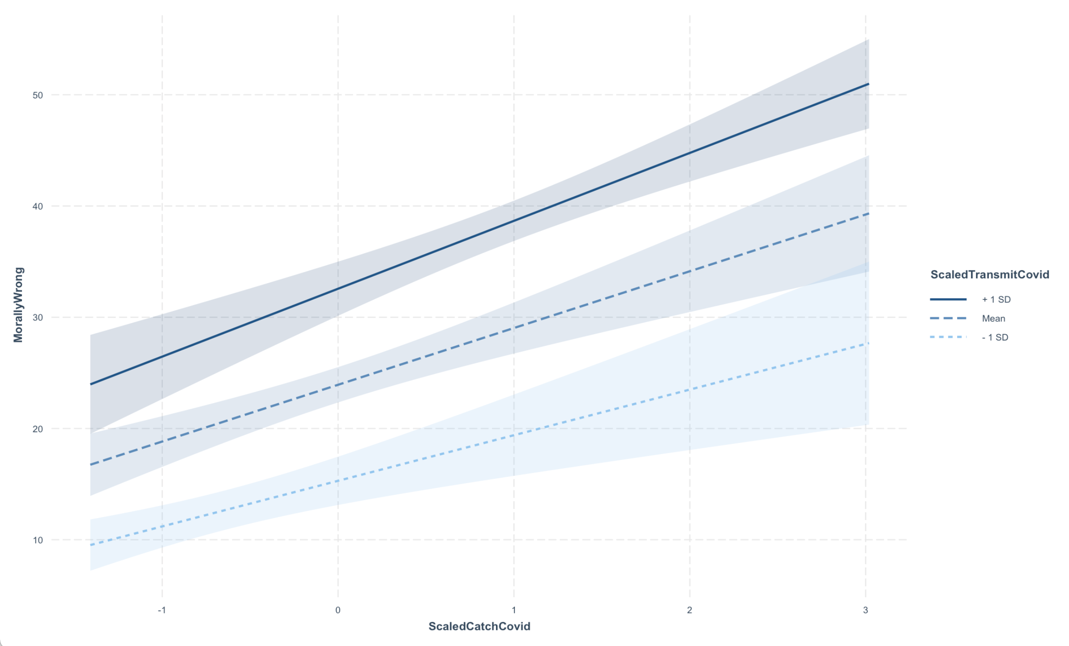
MorallyWrong
CatchCovid
CatchCovidTransmitCovid
TransmitCovid

Slide 12
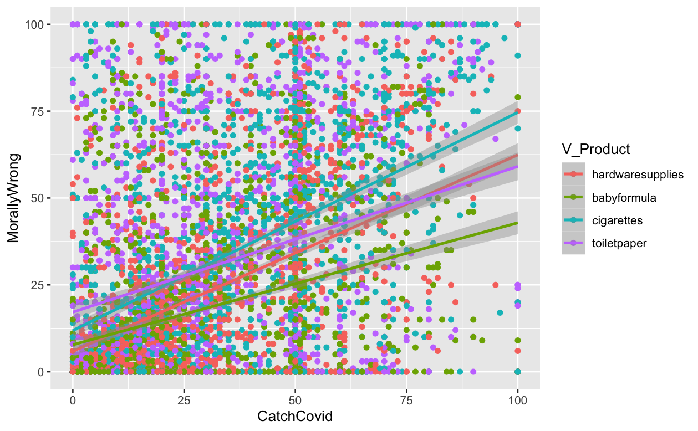
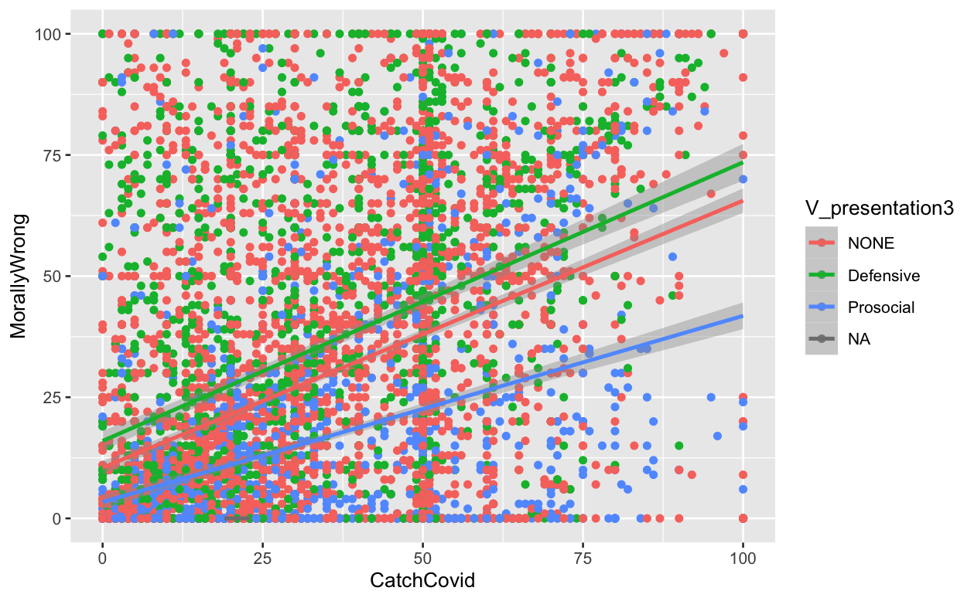
1.2 Update Model

Slide 13
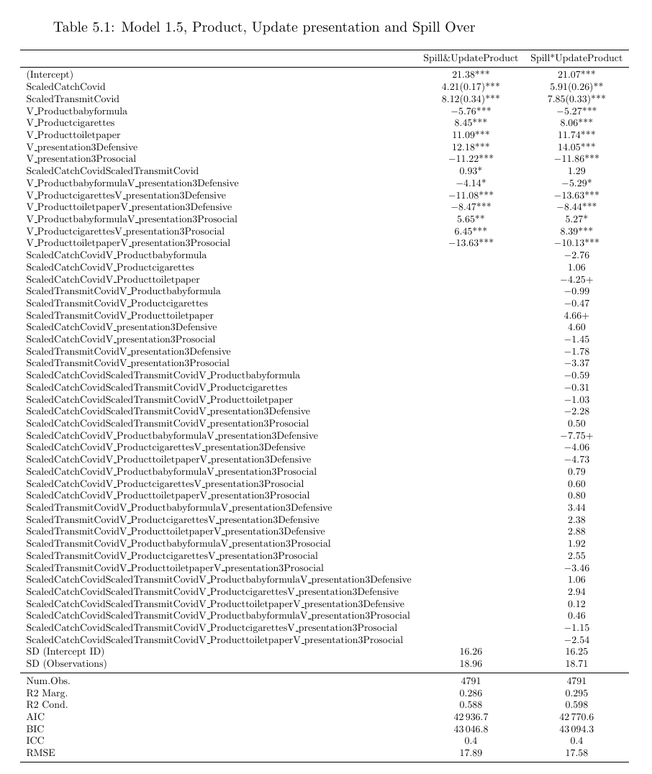
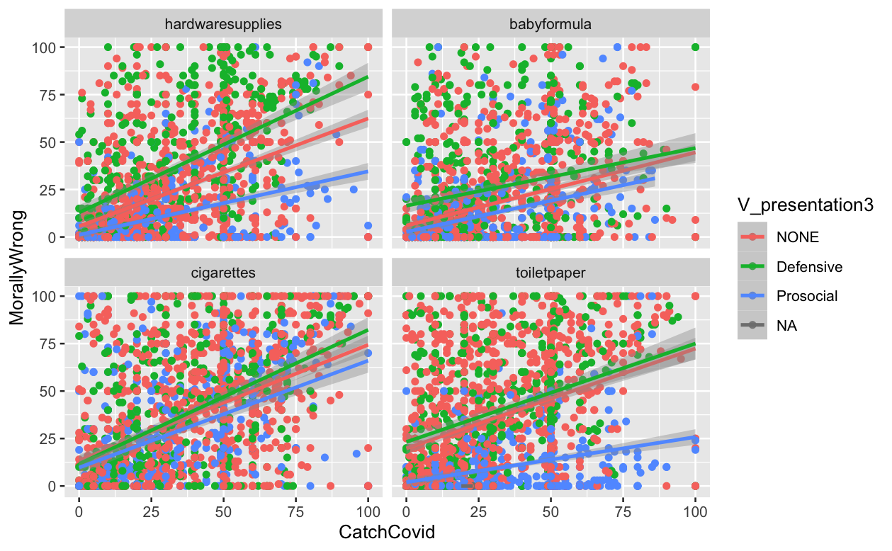
1.5 Spill over effect, Update and Product model

Slide 14
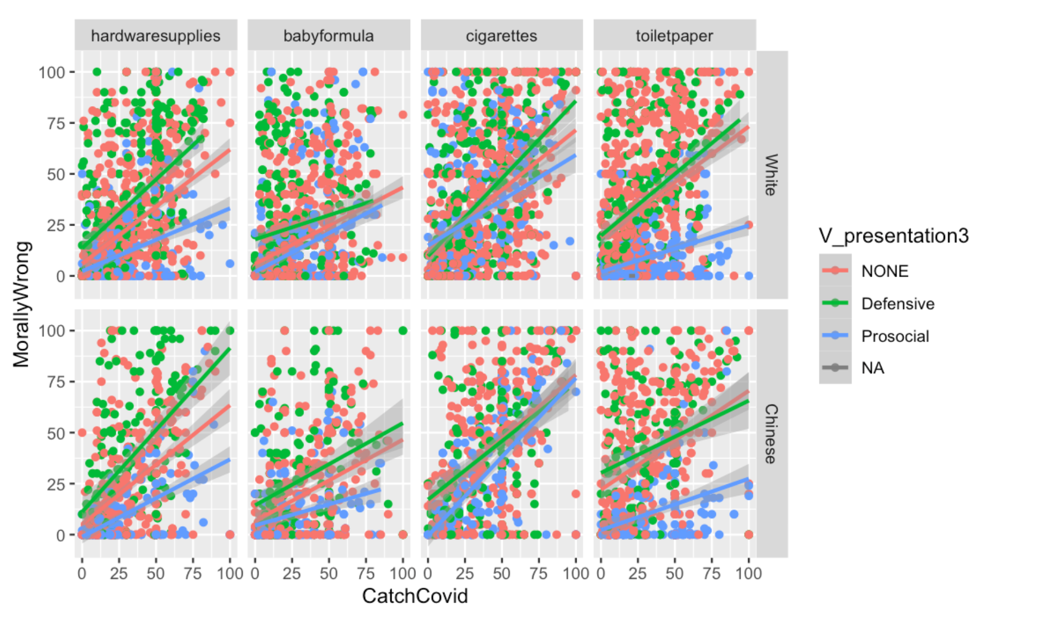
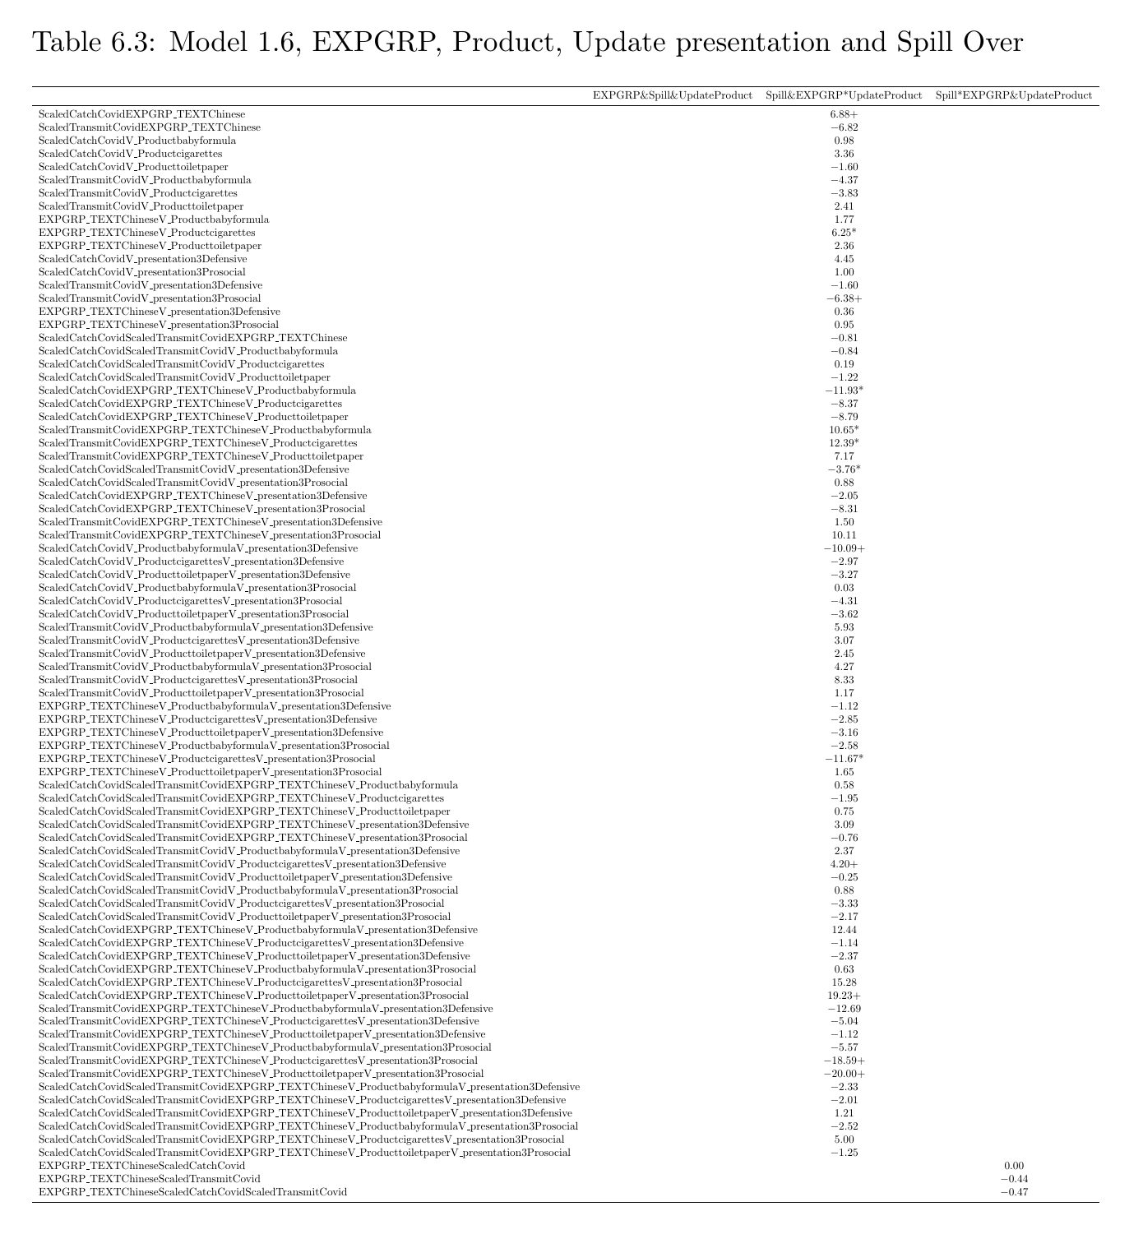
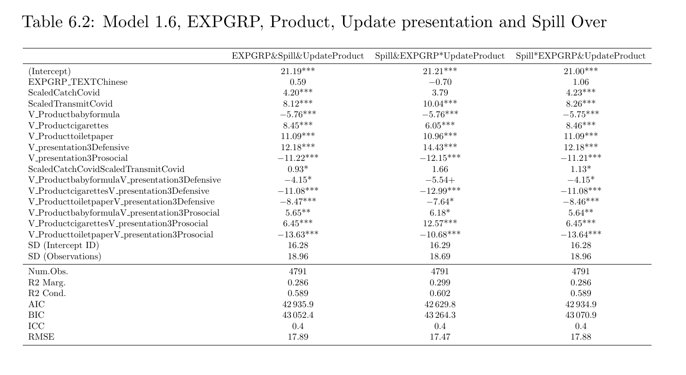

Slide 15
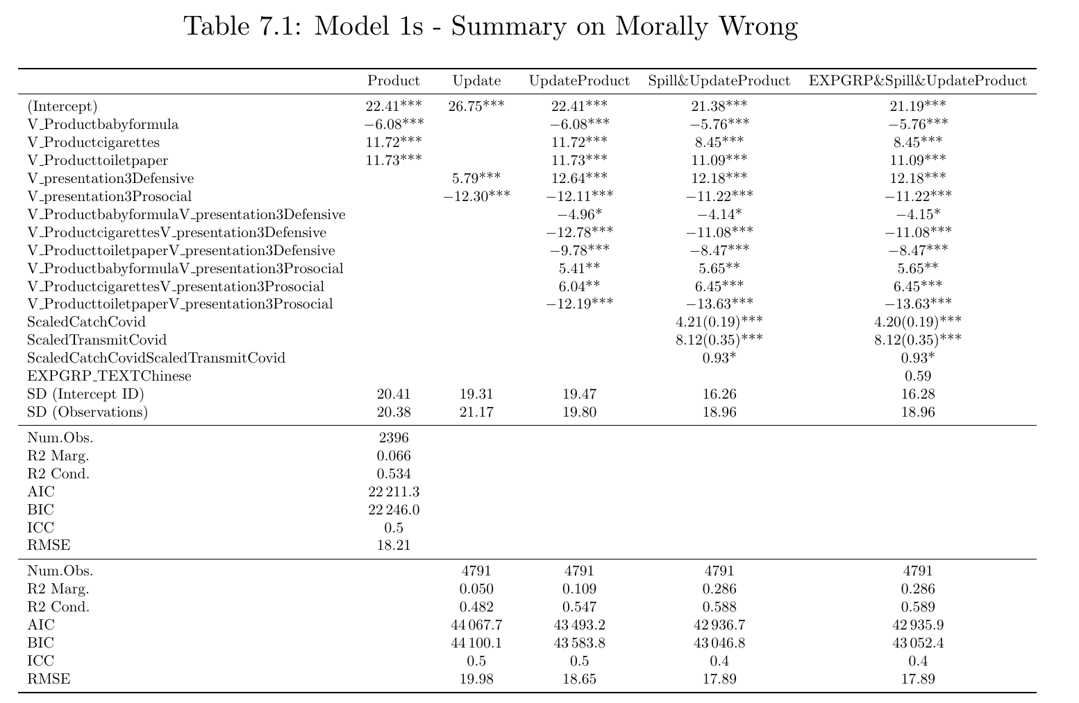
Model 1s Summary

Slide 16
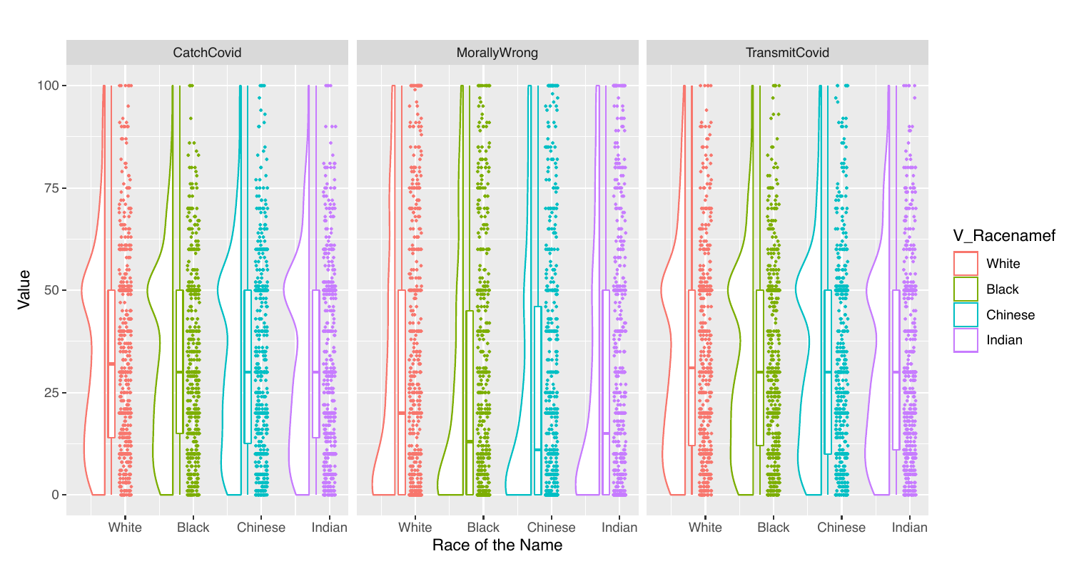
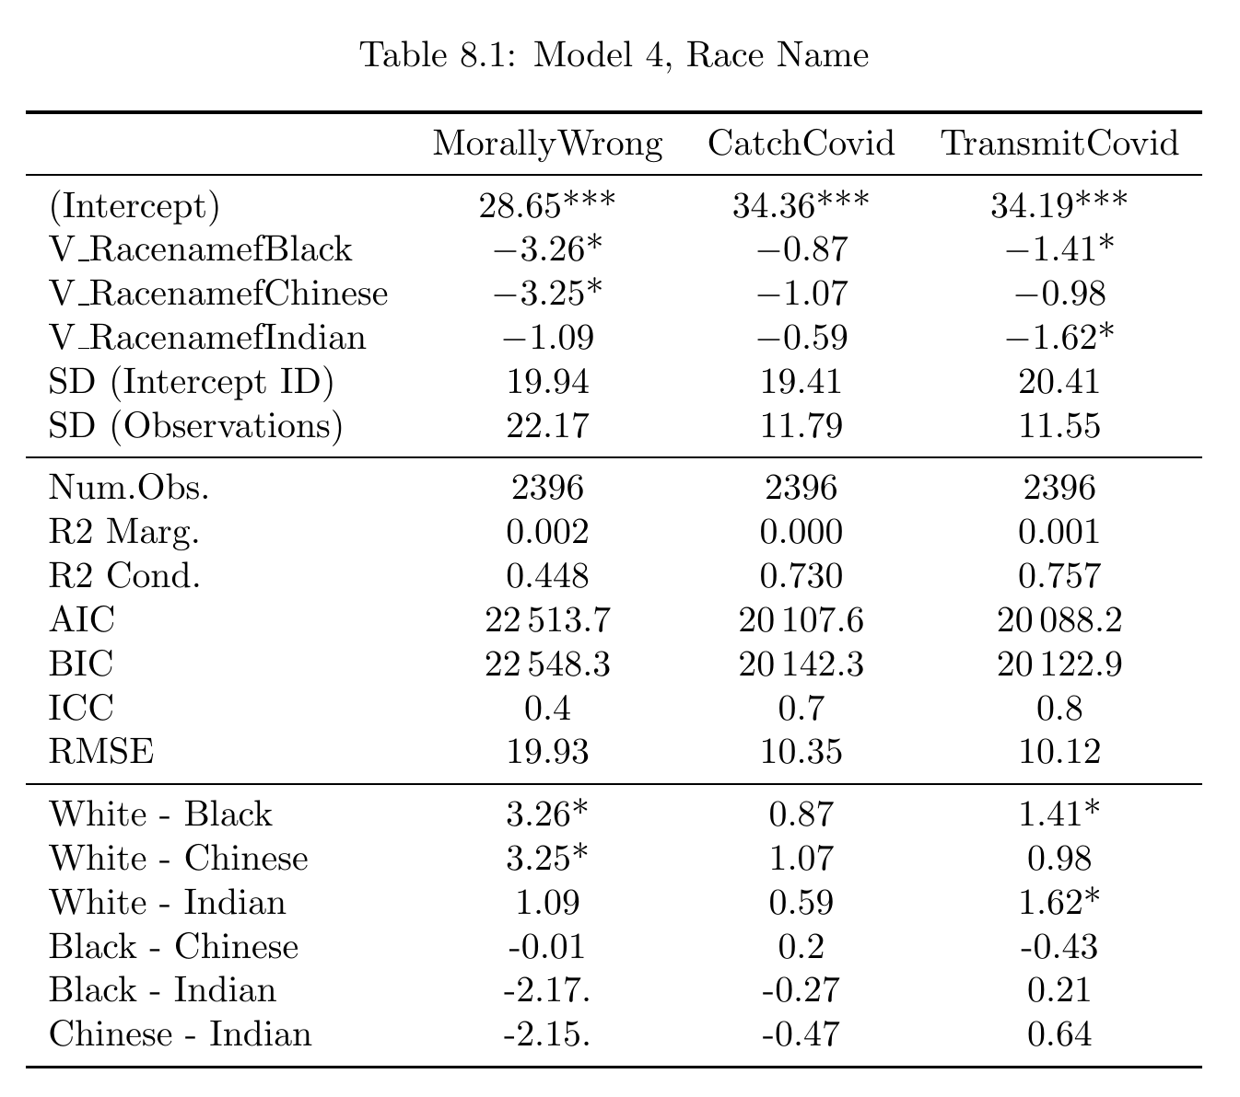
Perceived Race Model

Slide 17
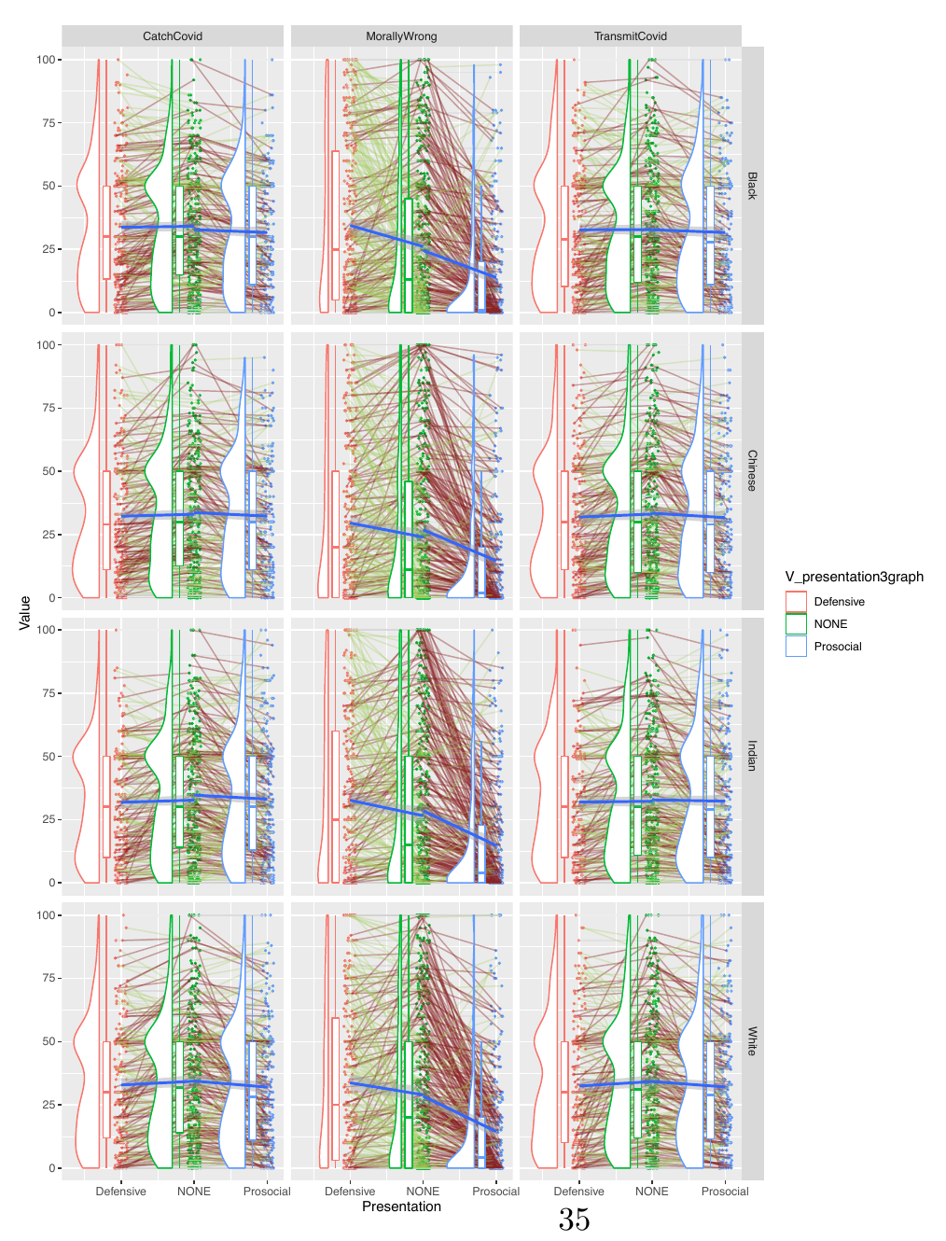
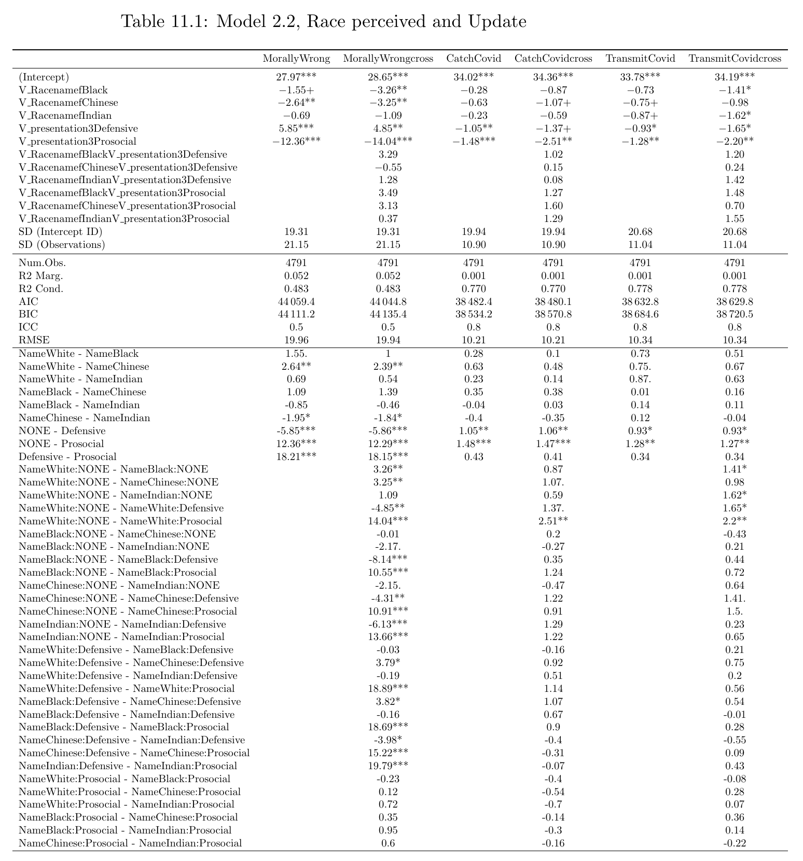
Perceived Race and Update Model

Slide 18
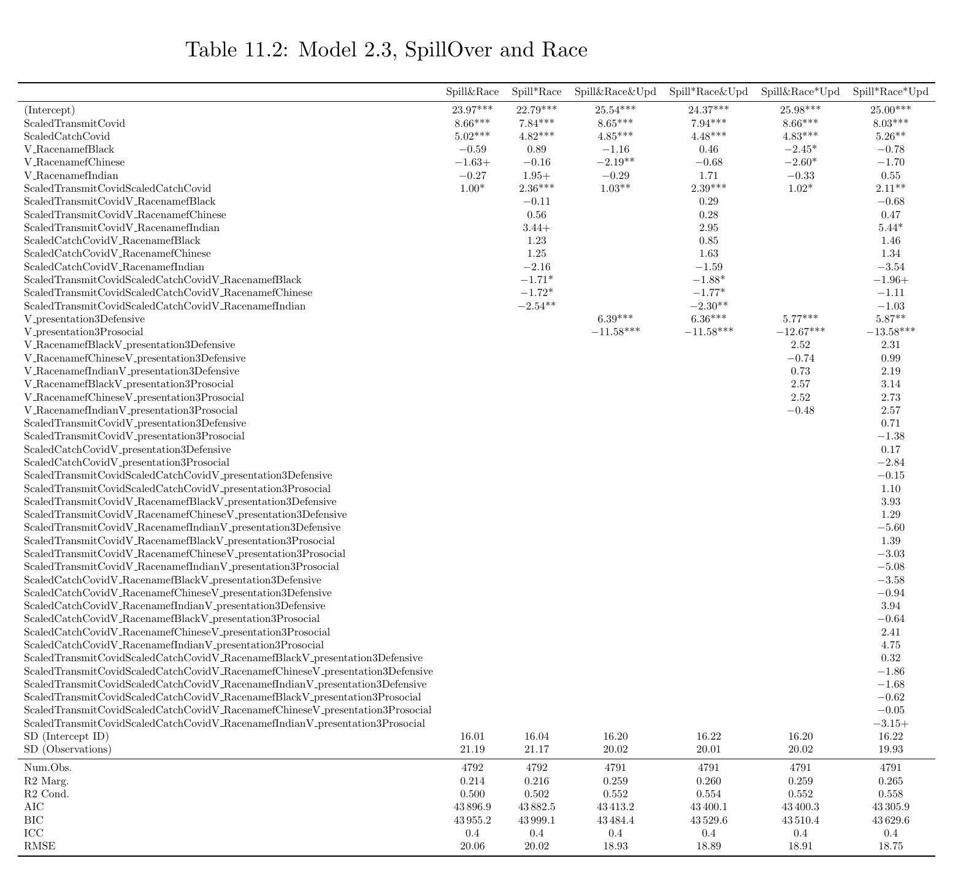
Perceived Race and SpillOver Model

Slide 19
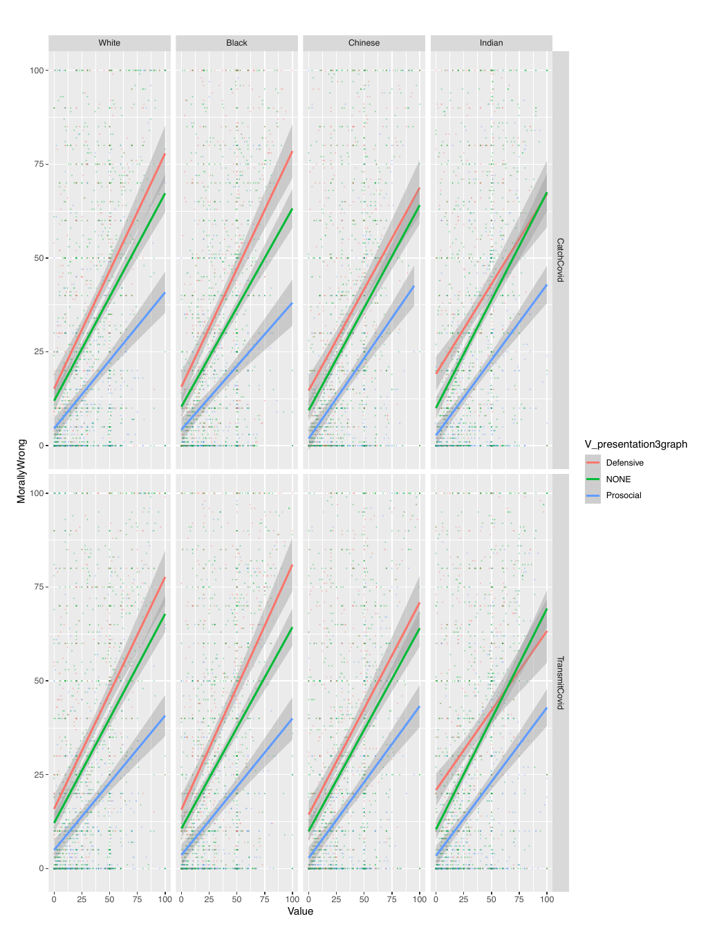
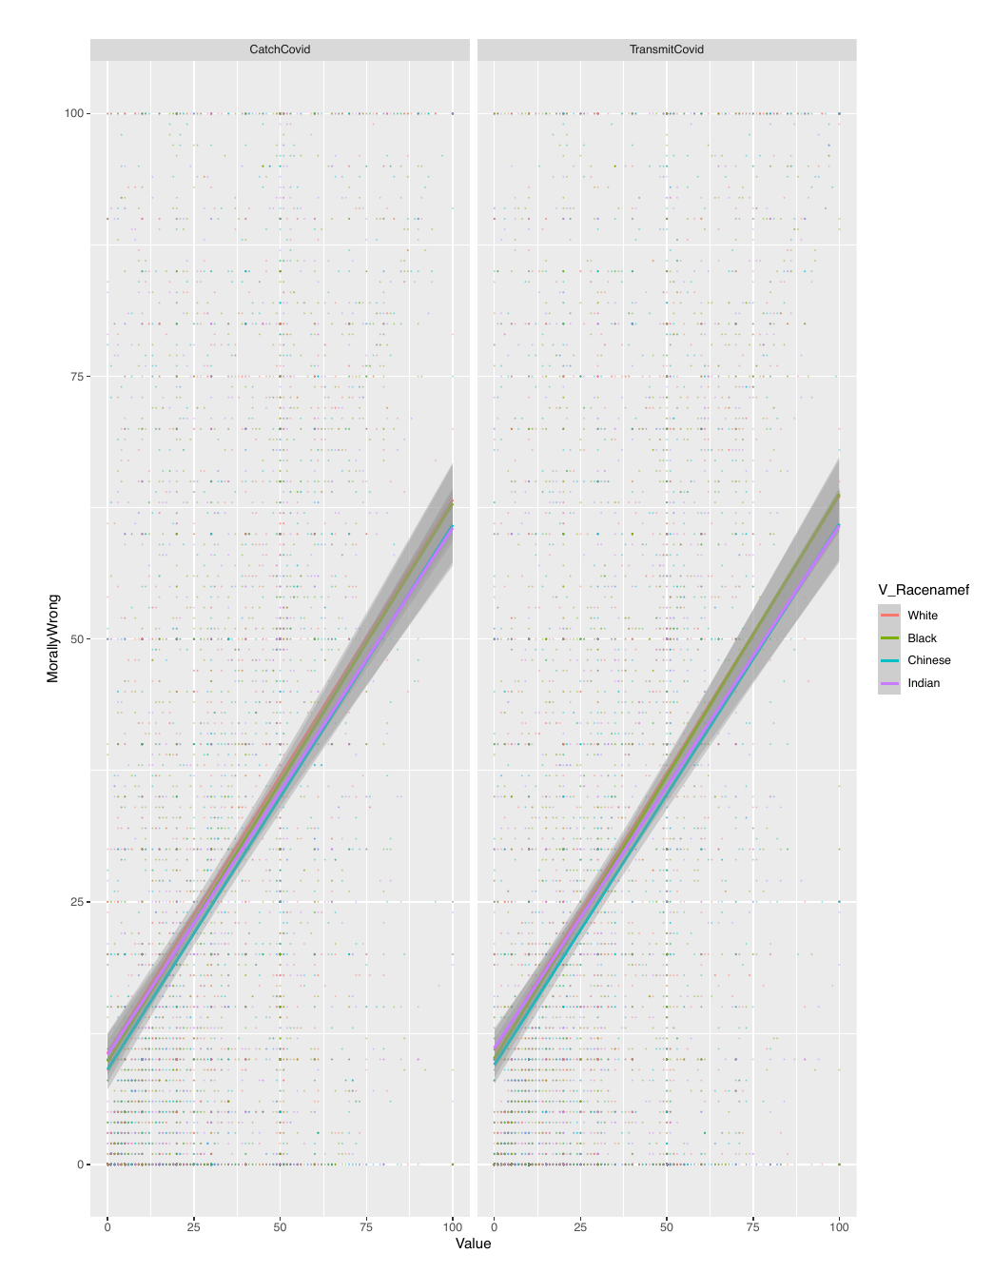
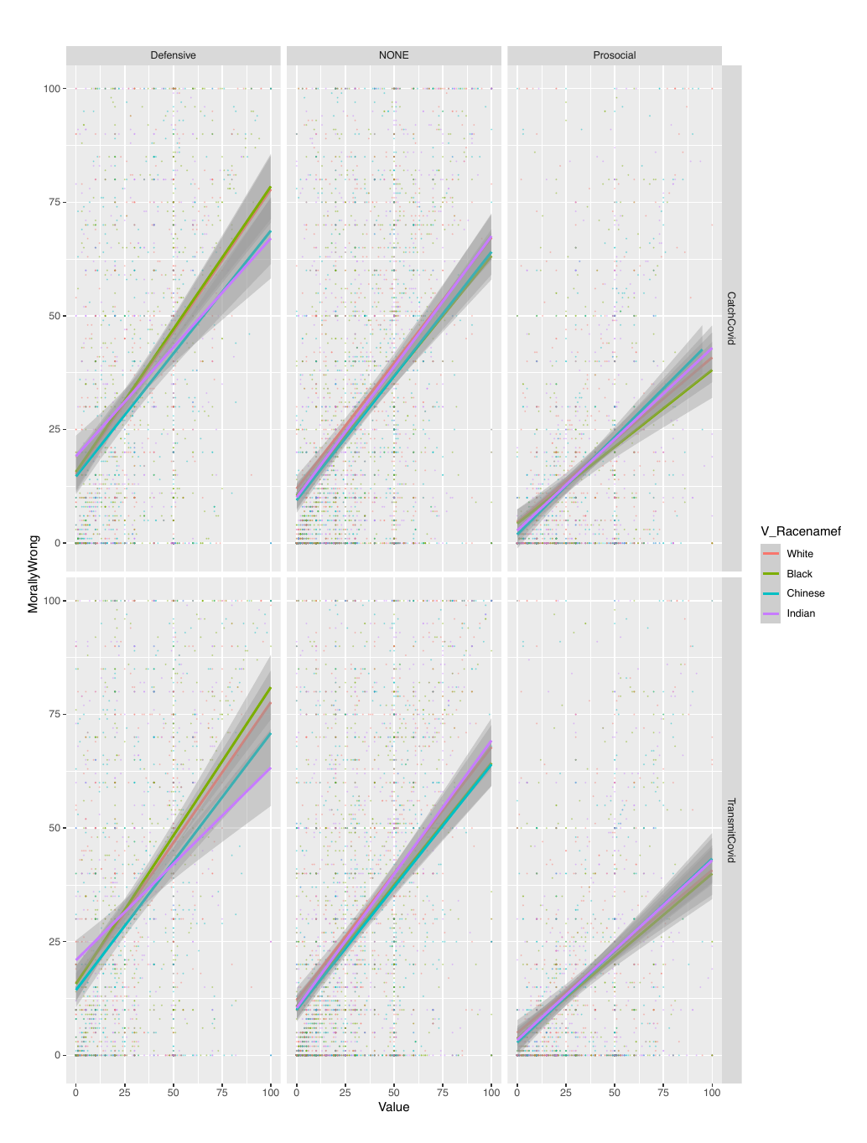
Perceived Race and SpillOver Model

Slide 20
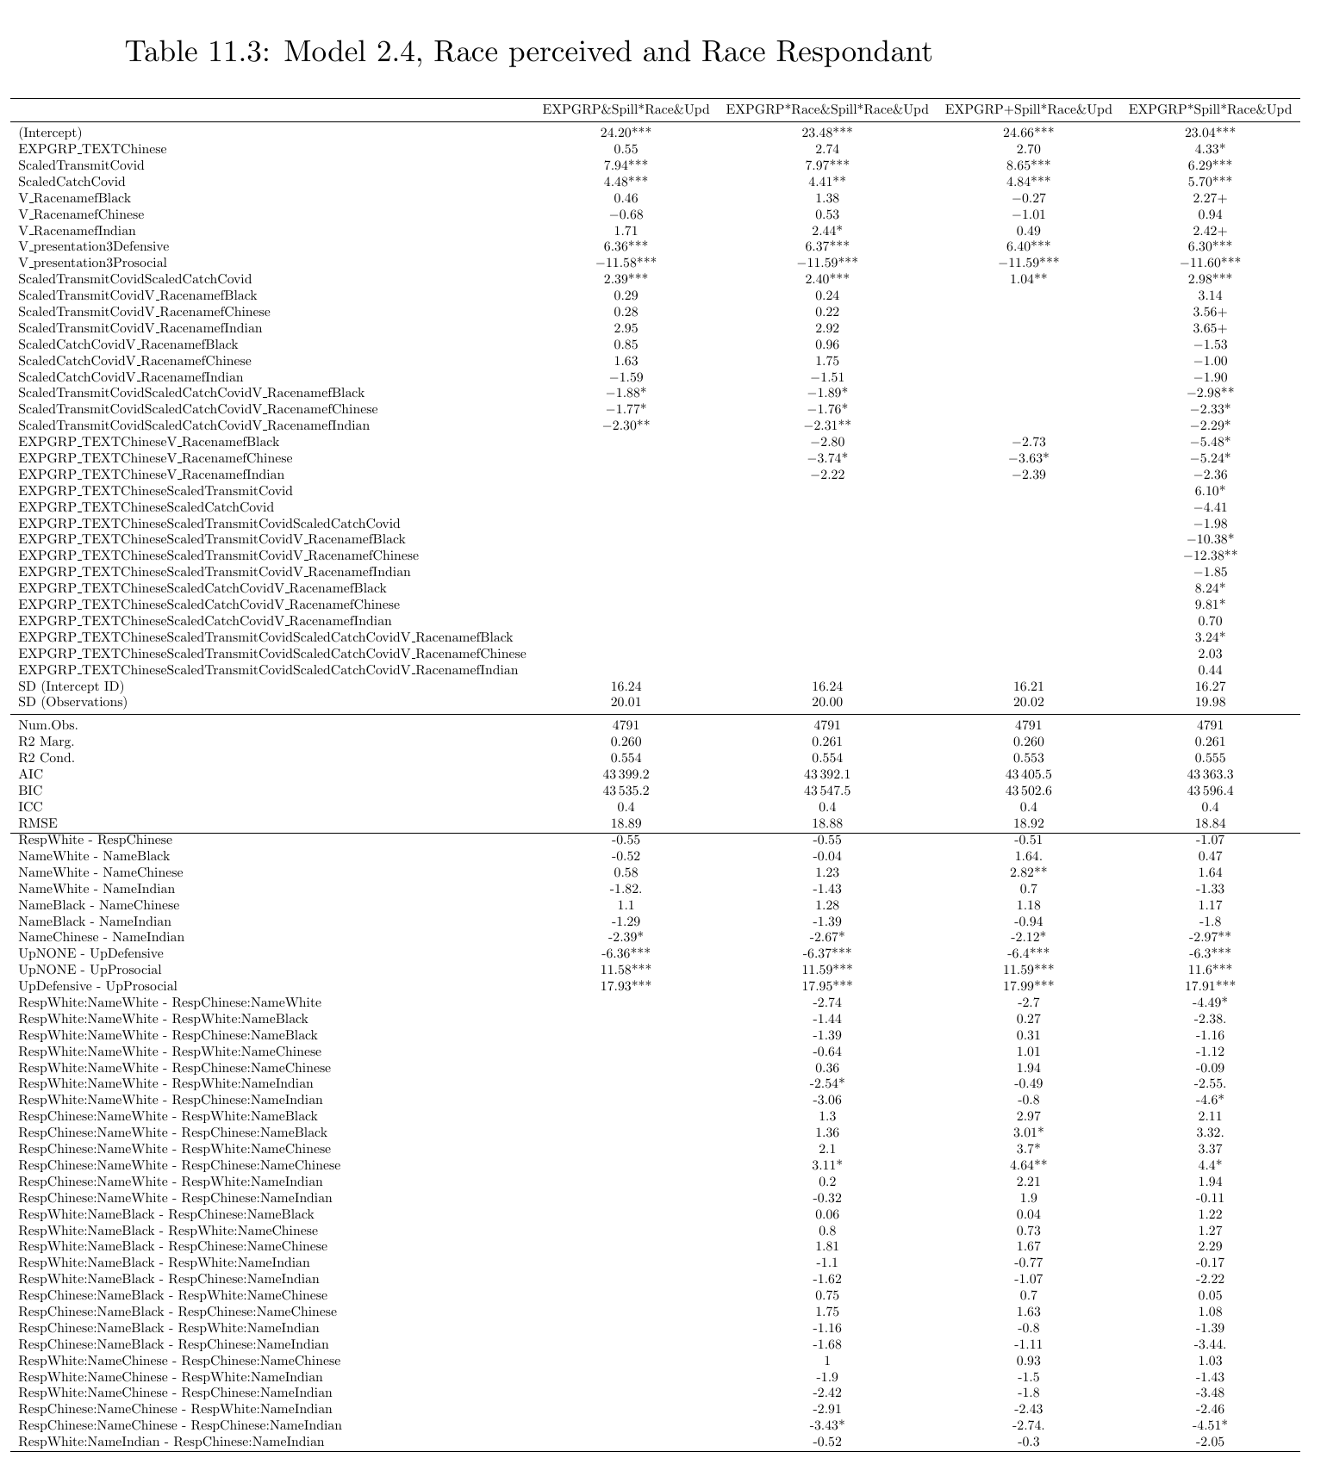
1.6 EXPGRP, Spill over effect, Update and Raceperceived model

Slide 21
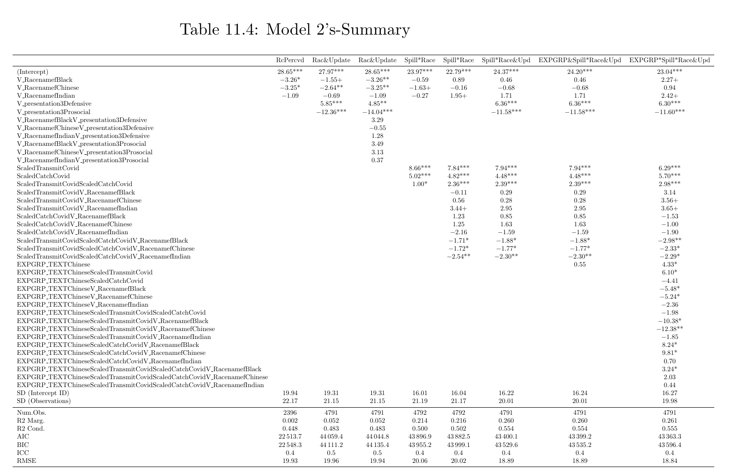
Model 2’s Summary

Slide 22
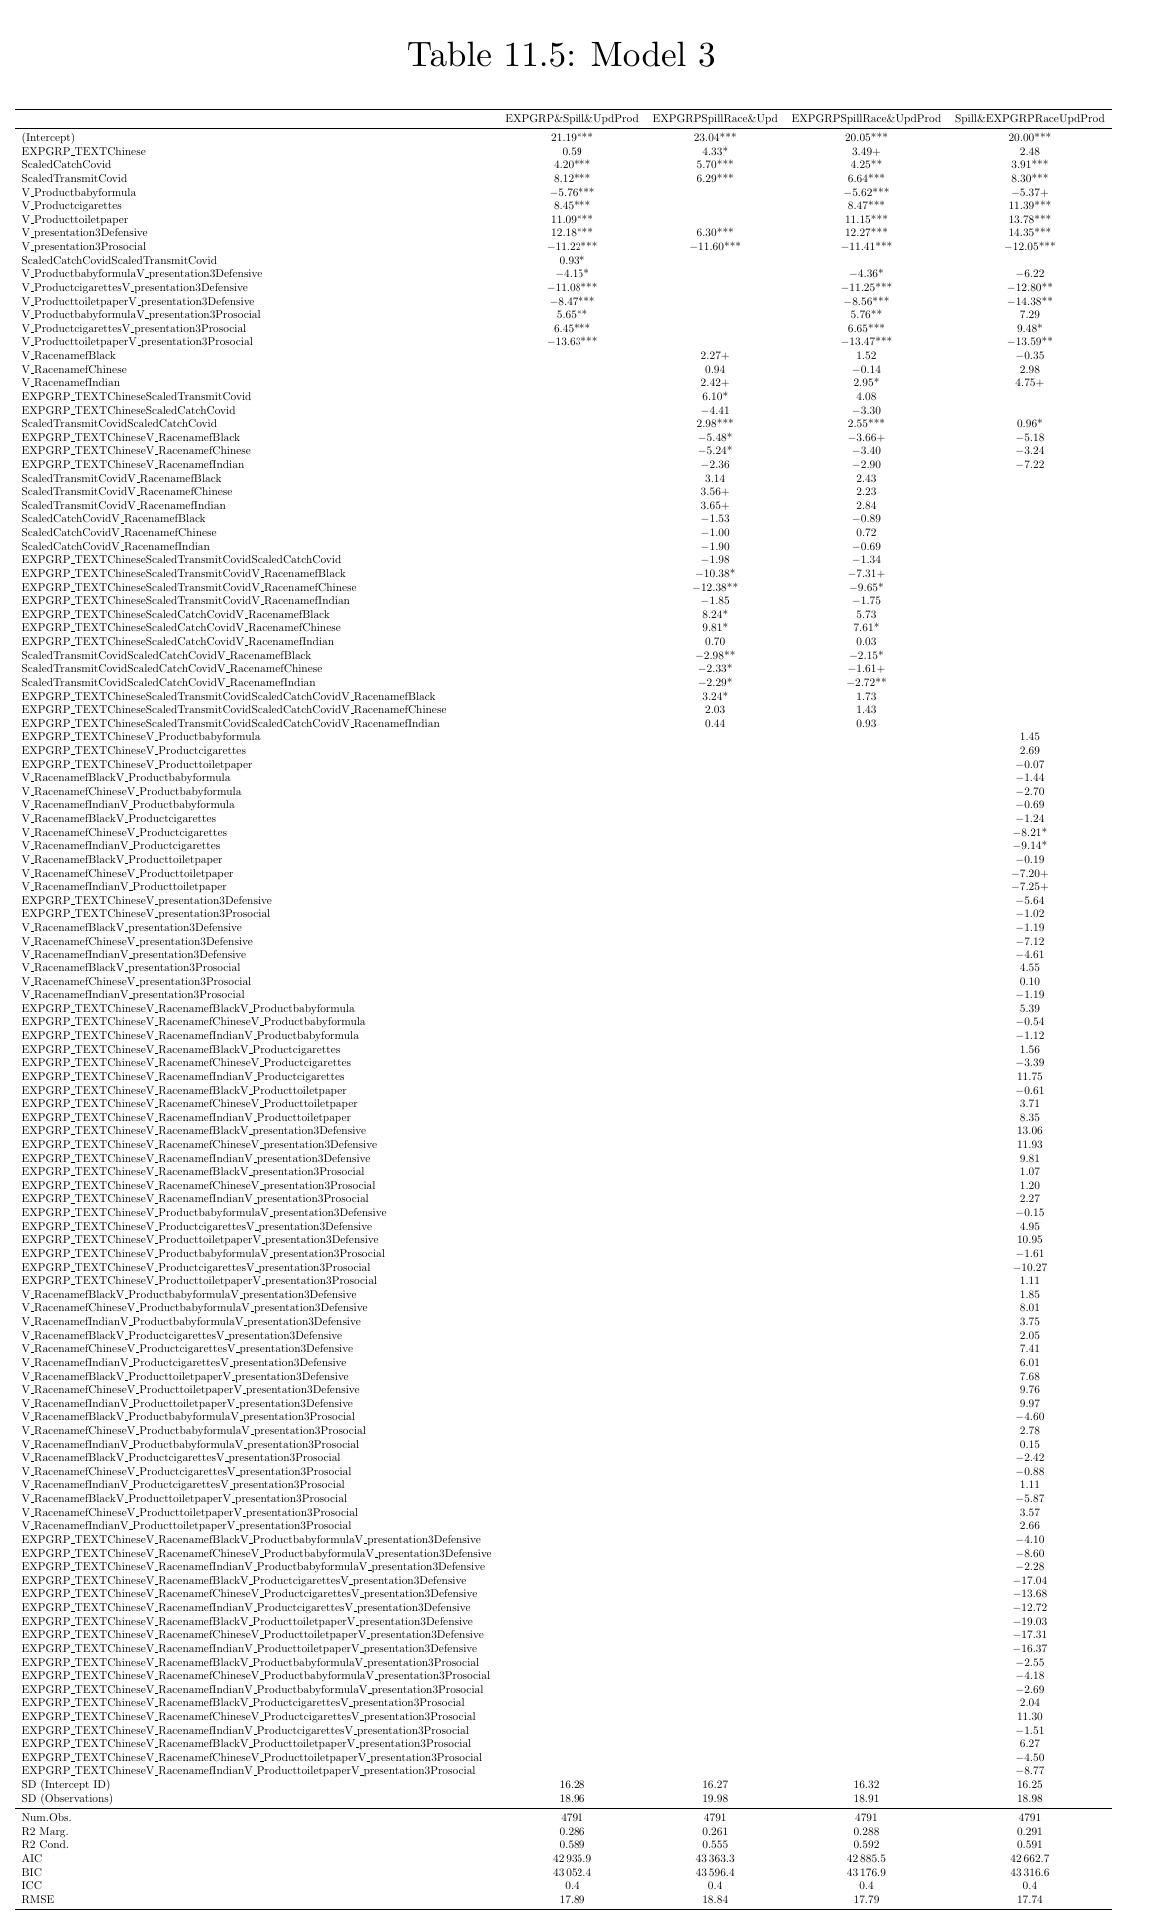
Model 3’s

